Slide 1


https://www.figma.com/design/0uzgthScA5IbYAbrWuEt1u/Untitled?node-id=0-1

Slide 2
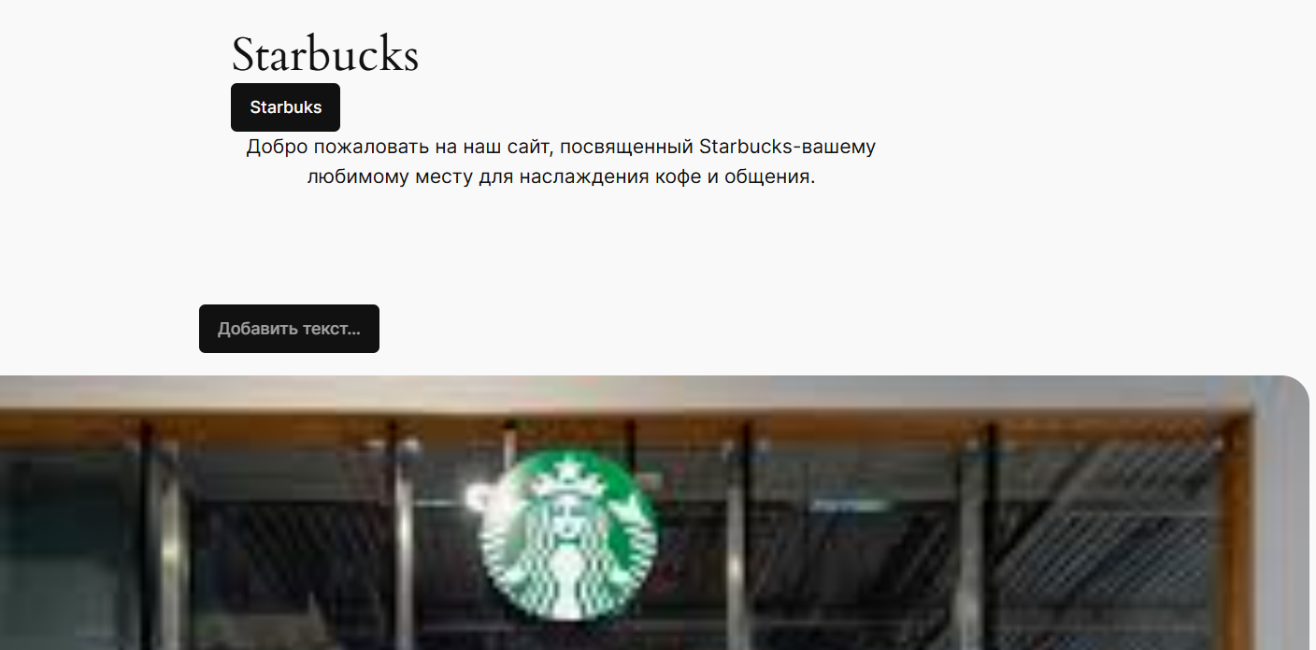
https://perizatcs14.wordpress.com/

